Slide 1
Merging of quenched dwarf galaxies
By Carol, Kristian, and Lea

Slide 2
Goal of the project
Investigate if a merger of two quenched low mass dwarf galaxies can trigger star formation

Slide 3
Literature
Gao et al., Merger-induced star formation in low-metallicity dwarf galaxy NGC 4809/4810, 2023
Baron et al., Star formation and molecular gas properties of post-starburst galaxies, 2023
Li et al., The Subtle Effects of Mergers on Star Formation in Nearby Galaxies, 2023
Rathore et al.,Star-forming S0 Galaxies in SDSS-MaNGA: fading spirals or rejuvenated S0s?,2023
Pearson et al., Effect of galaxy mergers on star-formation rates, 2019

Slide 4
Gao et al., Merger-induced star formation in low-metallicity dwarf galaxy NGC 4809/4810, 2023
“The merging stage of two dwarf galaxies can induce starburst activities at the interaction areas, despite the metal-deficient environment. Considering the high specific SFRs and different stellar ages, we propose that the interaction initially triggered star formation in NGC 4809 and then drove star formation in NGC 4810.”
“In NGC 4809, the star formation rate remains constant with time, whereas in NGC 4810, the stellar mass assembly process is more efficient. These might indicate that galaxy interaction first destabilize the molecular gas cloud in NGC 4809, then transport molecular gas into NGC 4810 and create new stars.”

Slide 5
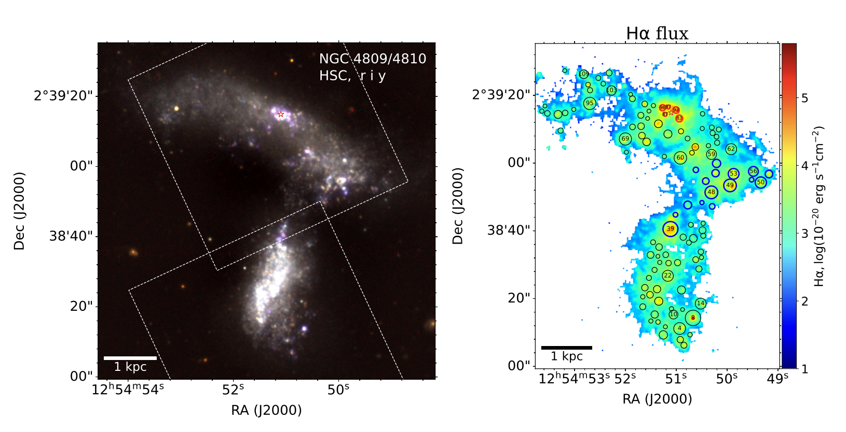

Slide 6
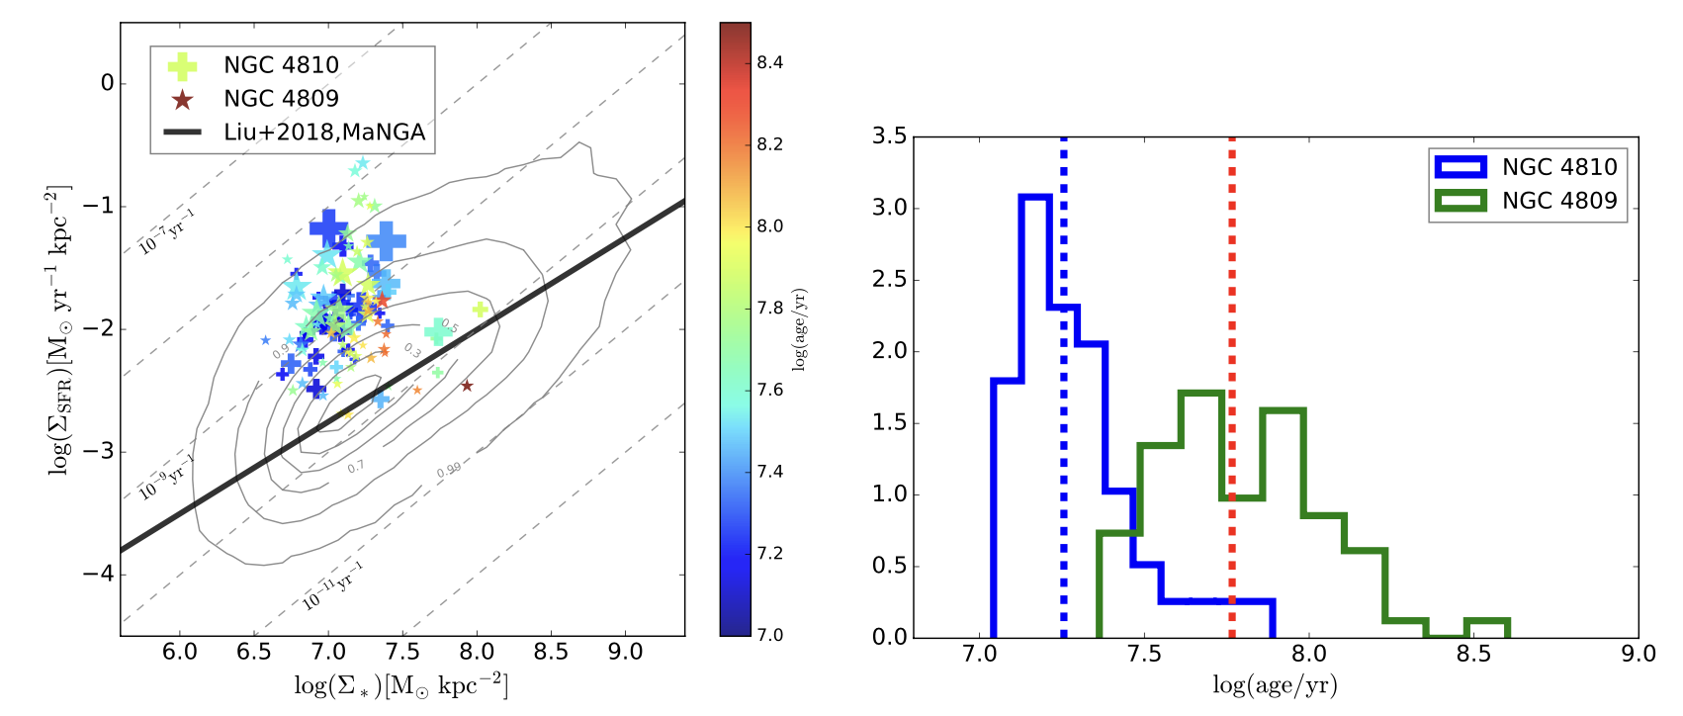

Slide 7
Rathore et al., Star-forming S0 Galaxies in SDSS-MaNGA: fading spirals or rejuvenated S0s?, 2023
“S0 galaxies are known to be in general red and non-star forming”
“in our sample of SF-S0s, star-formation has been rejuvenated, with minor mergers likely to be a major driver”

Slide 8
Baron et al., Star formation and molecular gas properties of post-starburst galaxies, 2023
“Our results show no contradiction with the common galaxy evolution picture, where the decrease in SFR is due to the consumption of molecular gas by the starburst.”

Slide 9
Li et al., The Subtle Effects of Mergers on Star Formation in Nearby Galaxies, 2023
“Among low-redshift galaxies, galaxy mergers, including those that involve gas-rich and nearly equal-mass galaxies, exert a minimal impact on their SFR, specific SFR, or star formation efficiency. Starbursts are rare. The star formation efficiency of gas-rich, minor mergers even appears suppressed.”
“Contrary to popular wisdom, we find no excess of star-bursts in gas-rich, major mergers. Gas-rich, minor mergers, if anything, form stars even less efficiently than non-merging galaxies.”

Slide 10
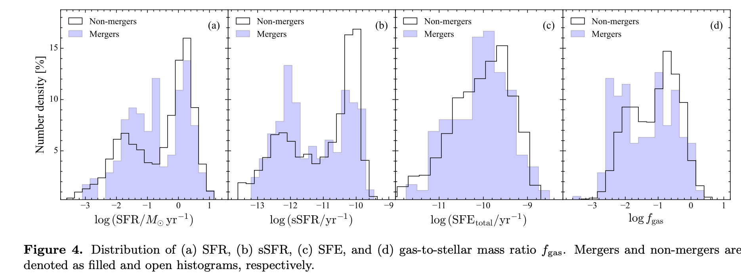

Slide 11
Pearson et al., Effect of galaxy mergers on star-formation rates, 2019
“Galaxy mergers have little effect on the SFR of the majority of merging galaxies compared to the non-merging galaxies. The typical change in SFR is less than 0.1 dex in either direction. Larger changes in SFR can be seen but are less common. The increase in merger fraction as the distance above the galaxy main sequence increases demonstrates that galaxy mergers can induce starbursts.”

Slide 12
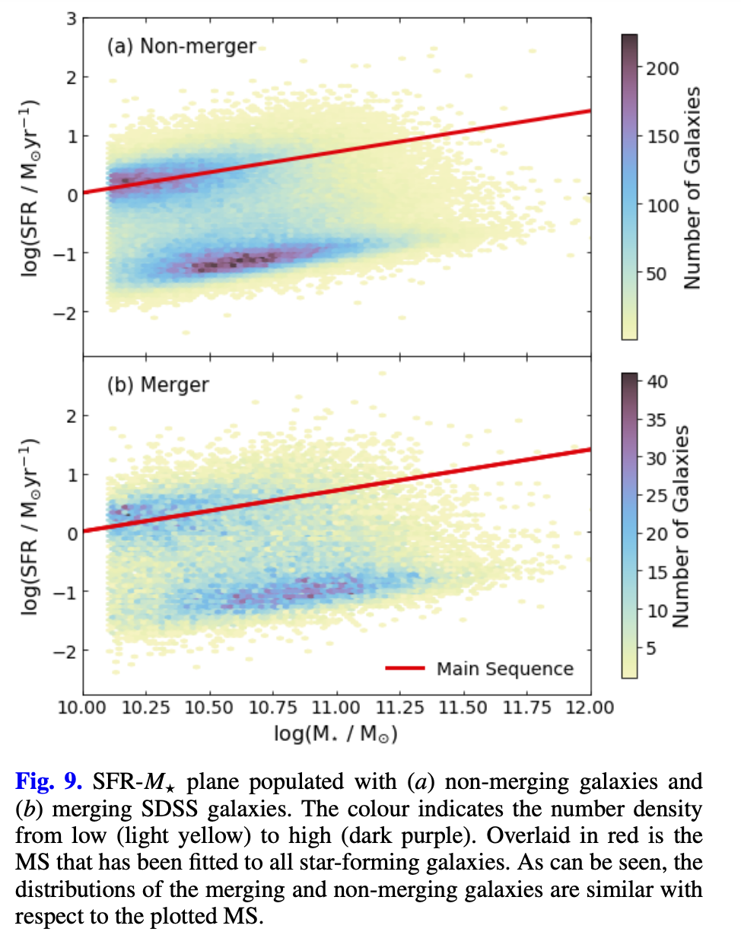
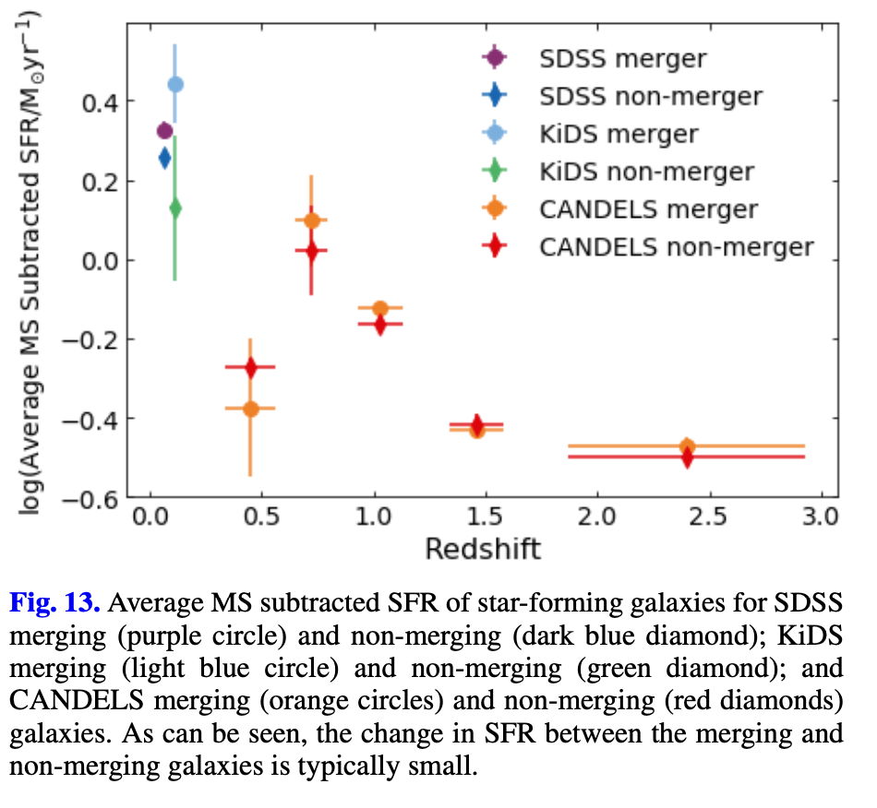

Slide 13
Planned phases of the project

Slide 14
Step 1: Single gas cloud
Setup simple spherical cloud
Hydrodynamics and gravity
Check star formation rate of cloud
Fine-tune until SFR goes to 0

Slide 15
Step 2: Merging gas clouds
Create two gas clouds
Set initial conditions for merger
Observe SFR before and after merger
See if this simple setup can trigger star formation

Slide 16
Step 3: Realistic dwarf galaxy
Using GalactICS package, set initial conditions to resemble actual quenched dwarf galaxies including non-gas components

Slide 17
Step 4: Final code
Combine everything:
Realistic quenched dwarf galaxies
Merger of 2 galaxies
Plot star formation rate as function of time

